Slide 1
Common Core Algebra II
Talk and Tools for Statistics and Probability
eMathInstruction
Tools for Teaching Math in the 21st Century
NCAMS Winter Luncheon with Kirk Weiler

Slide 2
My Background
A couple of degrees in engineering
17 years of teaching at Arlington High School
Courses have ranged from two year Algebra to AP Calculus (and beyond)
Coordinator of the Math Department for the last five years (23 math courses, 25 math teachers but, who’s counting ;-)
In 2005 started the Arlington Algebra Project
In 2008 started eMathInstruction

Slide 3
The Outline of Our Day
A Warm-Up Probability Problem (Do Now?)
Common Core Task Force Final Report Findings and Discussion
Brainstorming the CC Alg II PARCC Standards and NYSED Clarifications
Break (you’ll need one)
Digging Into the CC Alg II Probability Standards
Lunch
Looking at Central Themes in CC Alg II Statistics Standards
Break
Using the Desmos Website for CC Alg II and More

Slide 4
A Warm Up Probability Problem
Two people are playing a game where Player #1 rolls two, standard, six-sided dice. Then, Player #2 rolls one, standard, six-sided die. Player #2 wins if the number on her roll is greater than both of the numbers that Player #1 rolled. What is the probability that Player #2 will win?
Create a simulation on your calculator and play the game at least 25 times. Record the number of times that Player #2 wins and send the results to Socrative - Room Number : 1IEV8YLC
Are these results consistent with the theoretical probability model for the problem?

Slide 5
The Theoretical Solution
The sample space consists of
equally likely outcomes.
The set of all outcomes when Player #2 wins can be broken into the following 6 disjoint events:
Player #2 Rolls a 1:
No rolls by Player #1 will cause Player #2 to win.
Player #2 Rolls a 2:
Only one roll by Player #1, i.e. (1, 1)
Player #2 Rolls a 3:
Four rolls by Player #1: (1, 1), (1, 2), (2, 1), and (2,2)
Player #2 Rolls a 4:
Nine rolls by Player #1: (1, 1), (1, 2), (1, 3), …, (3, 2), (3, 3)
Player #2 Rolls a 5:
16 rolls by Player #1: (1, 1), (1, 2), …, (4, 3), (4, 4)
Player #2 Rolls a 6:
25 rolls by Player #1: (1, 1), (1, 2), …, (5, 4), (5, 5)
There are a total of 1+4+9+16+25=55 out of 216 for a probability of around 0.255

Slide 6
Some Interesting Observations
What is the probability that Player #2’s roll is greater than the first roll of Player #1?
Why isn’t the probability of Player #2 winning this probability squared?

Slide 7

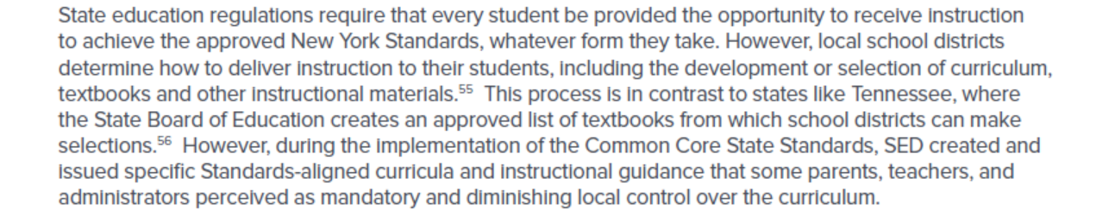
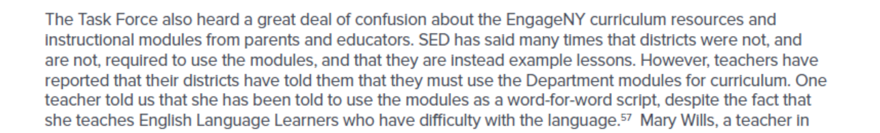


Slide 8
A Review of the Standards
Four yeas ago, NYSED decided to align its end of the year tests with the PARCC testing consortium with the stated intention of eventually adopting the PARCC End of Year exams for each grade level. Although they have backed away from these tests (as have most states), the Regents exams are still based on the PARCC End of Year assessment standards.
PARCC EOY Standards

Slide 9
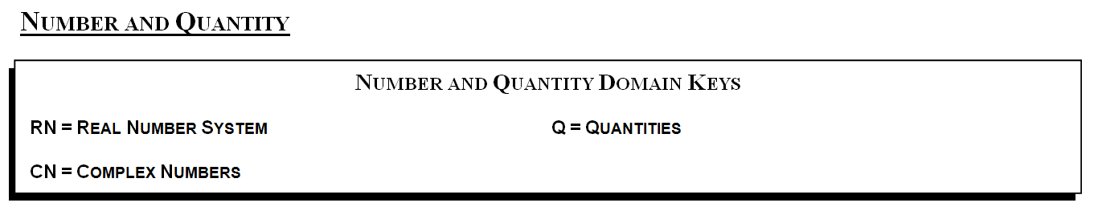
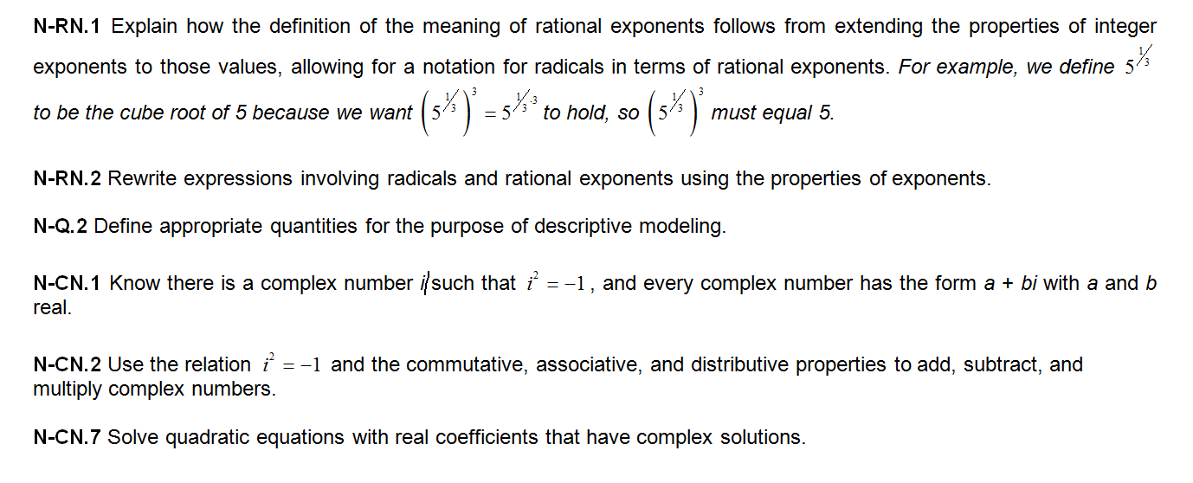

Slide 10
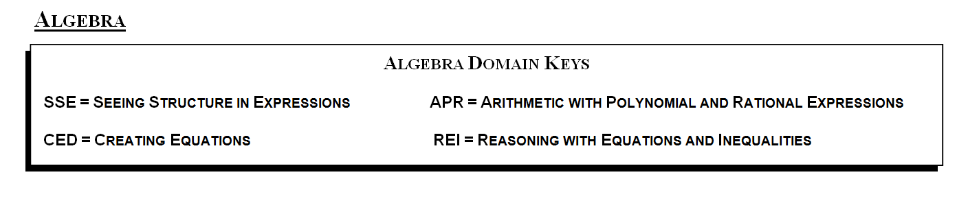
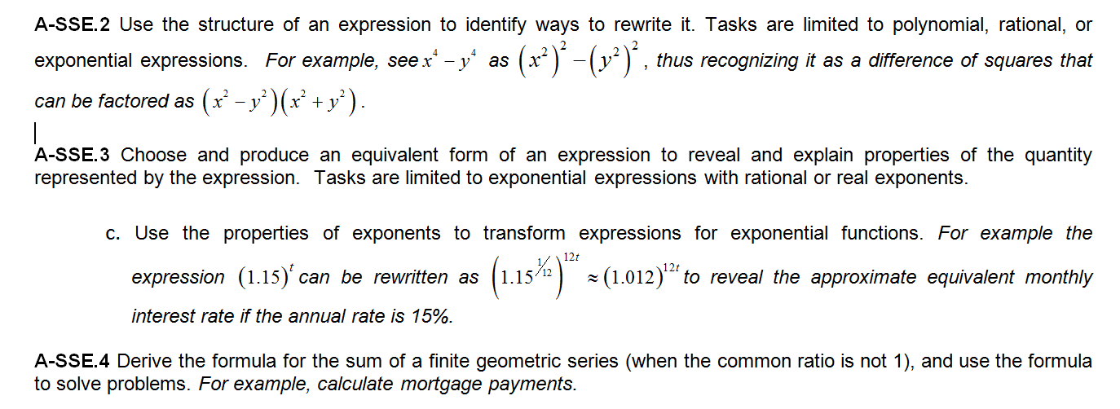

Slide 11
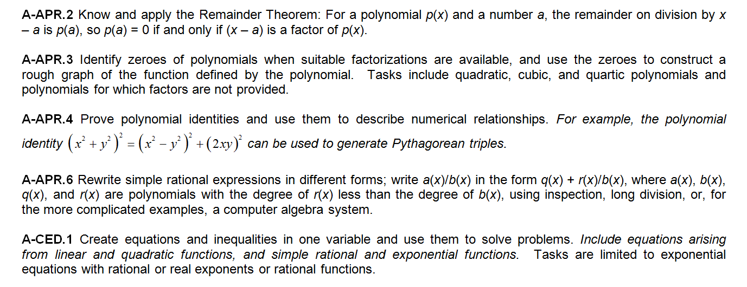

Slide 12
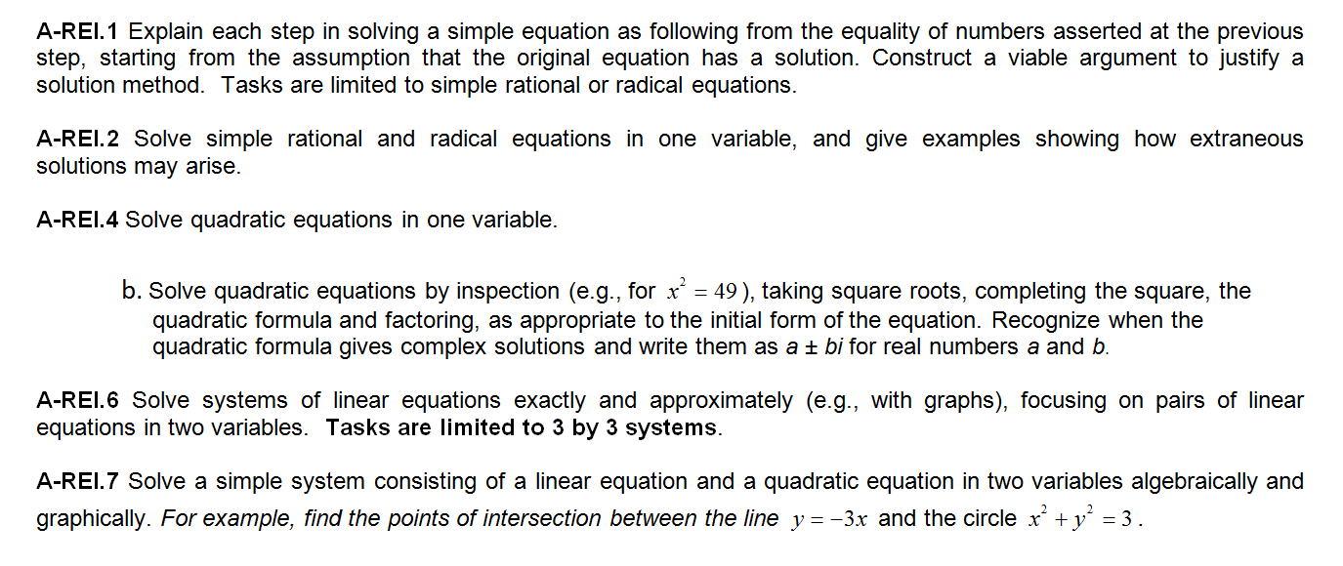
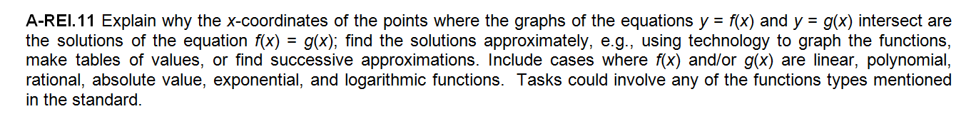

Slide 13
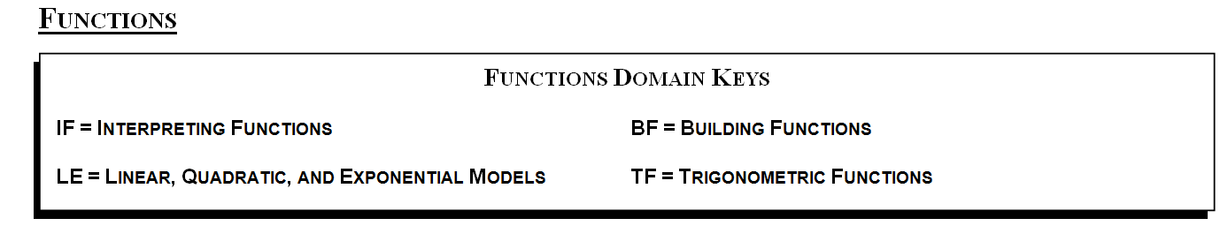
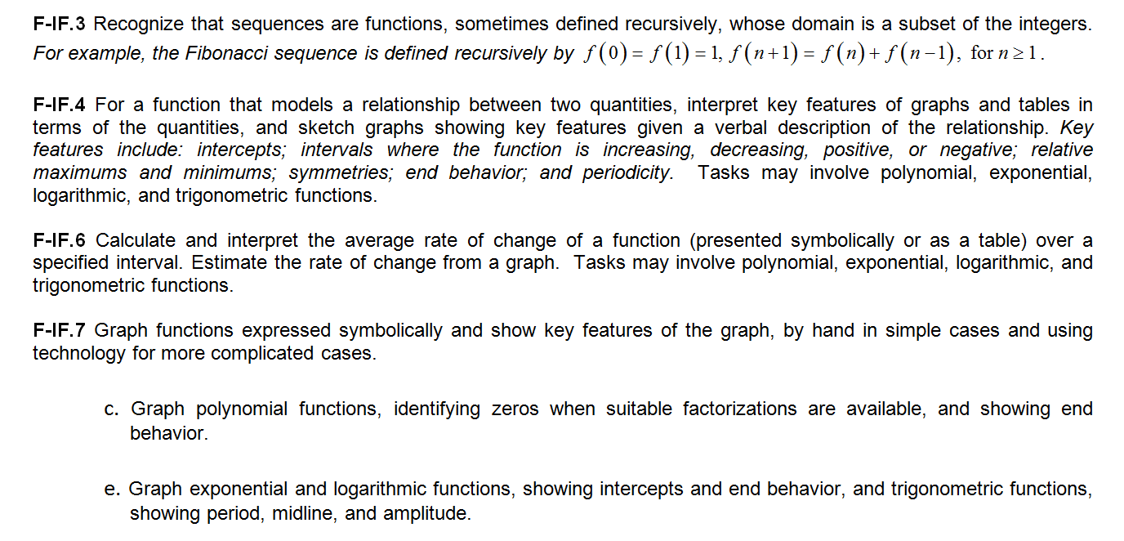

Slide 14
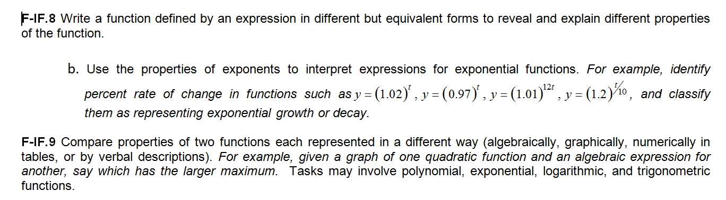

Slide 15
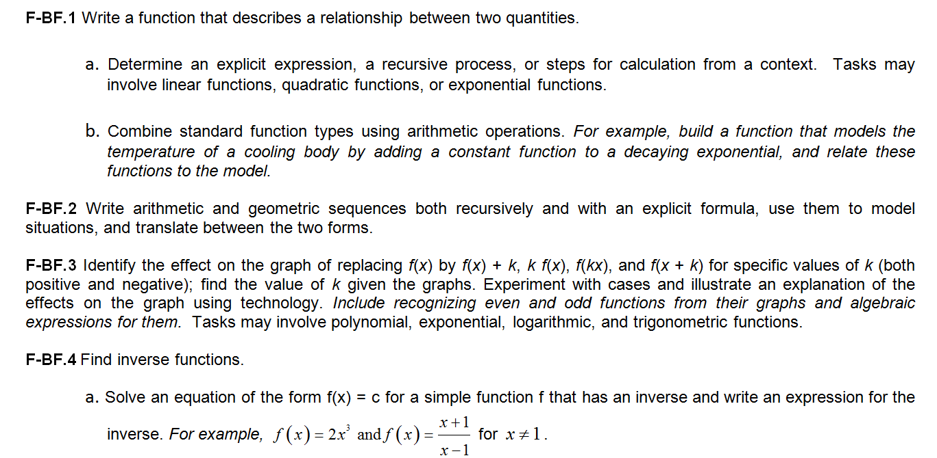

Slide 16
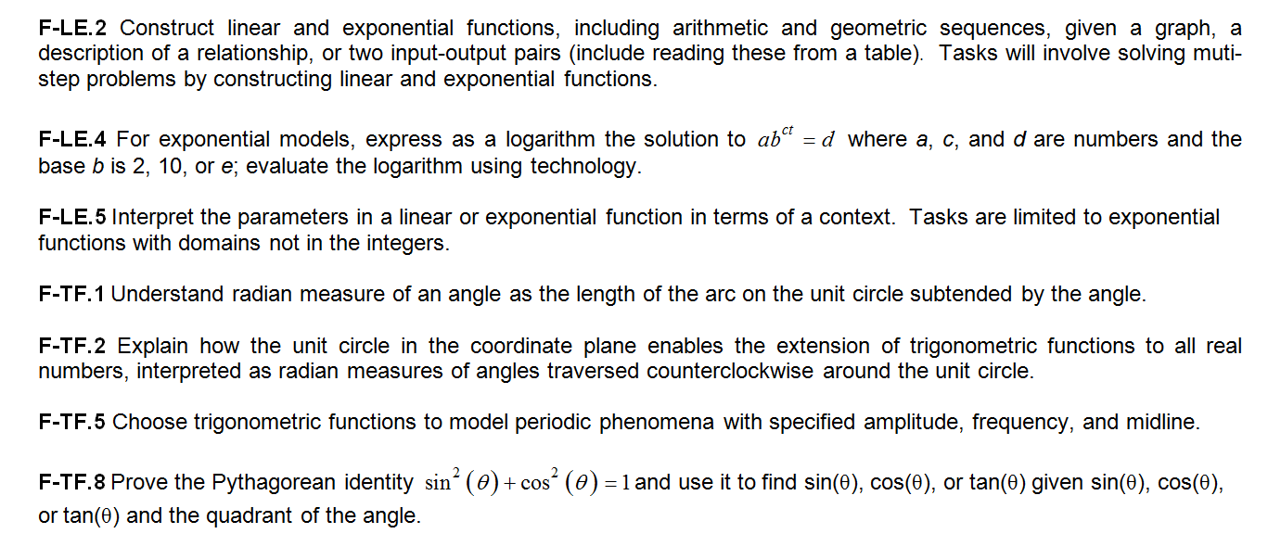

Slide 17
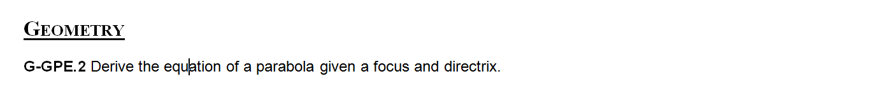
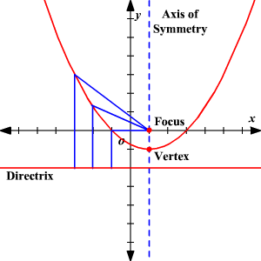

Slide 18
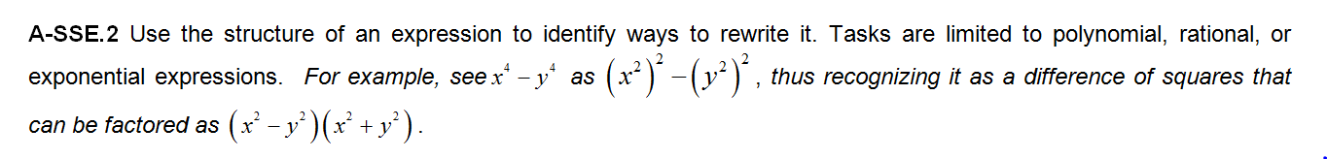
NYSED Clarifications

Slide 19
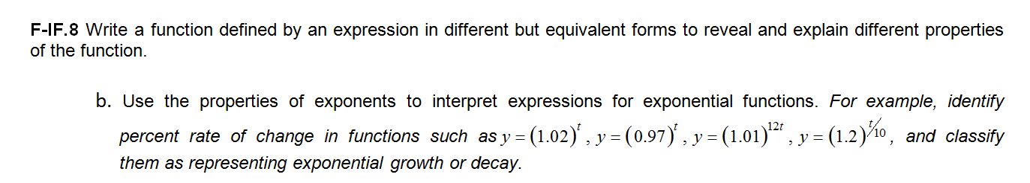


Slide 20
Topics Not Tested
Sometimes the opacity of the NYSED testing regime is difficult to understand (and to live with). Even with the PARCC EOY Standards and with the NYSED clarifications, we are still left with many questions about what content will be tested and what content will not be tested. Let’s take a look at some topics not tested on the CC Algebra II Regents exam.
Forum Post on Topics Not Tested on the CC Algebra II Regents Exam

Slide 21
Some Data Gathering on the Importance of Counting
(An Observational Study)
Please answer the questions on the current Socratic “quiz.” We will examine the results after some discussion of the probability and statistics standards.
Room Code: 1IEV8YLC

Slide 22
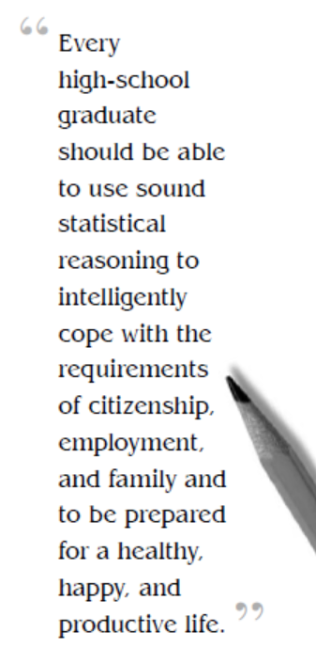
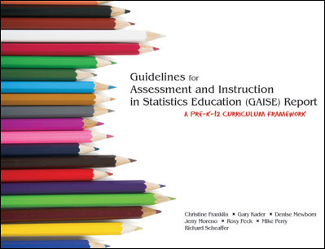
The GAISE Report/Framework

Slide 23
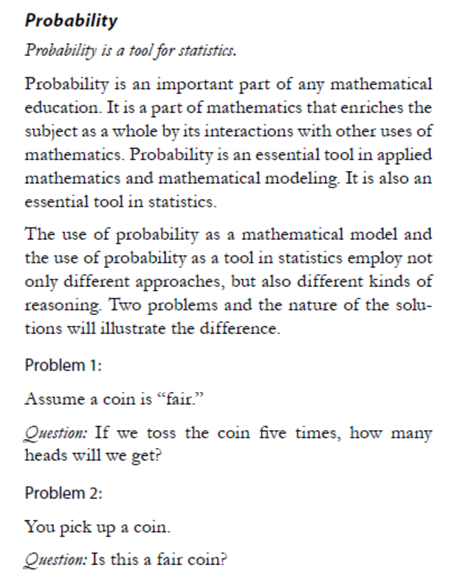
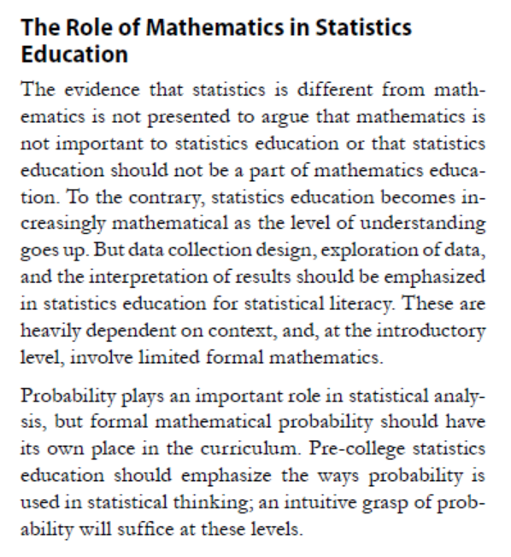
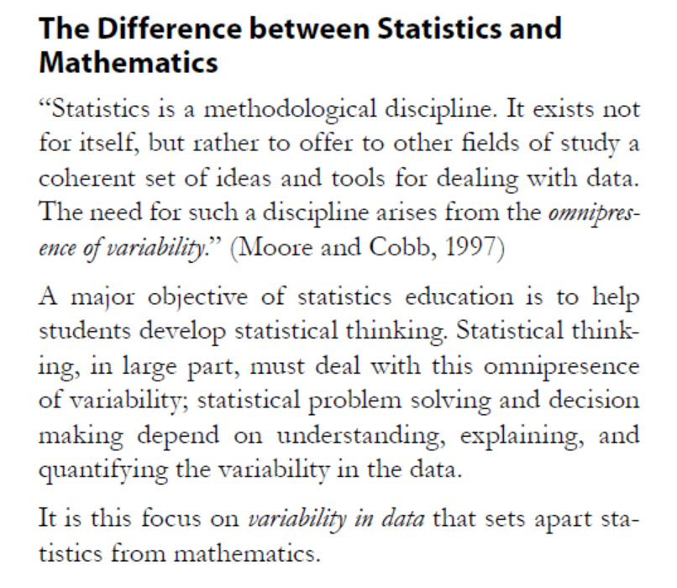
Some Key Pieces from Our GAISE Reading

Slide 24
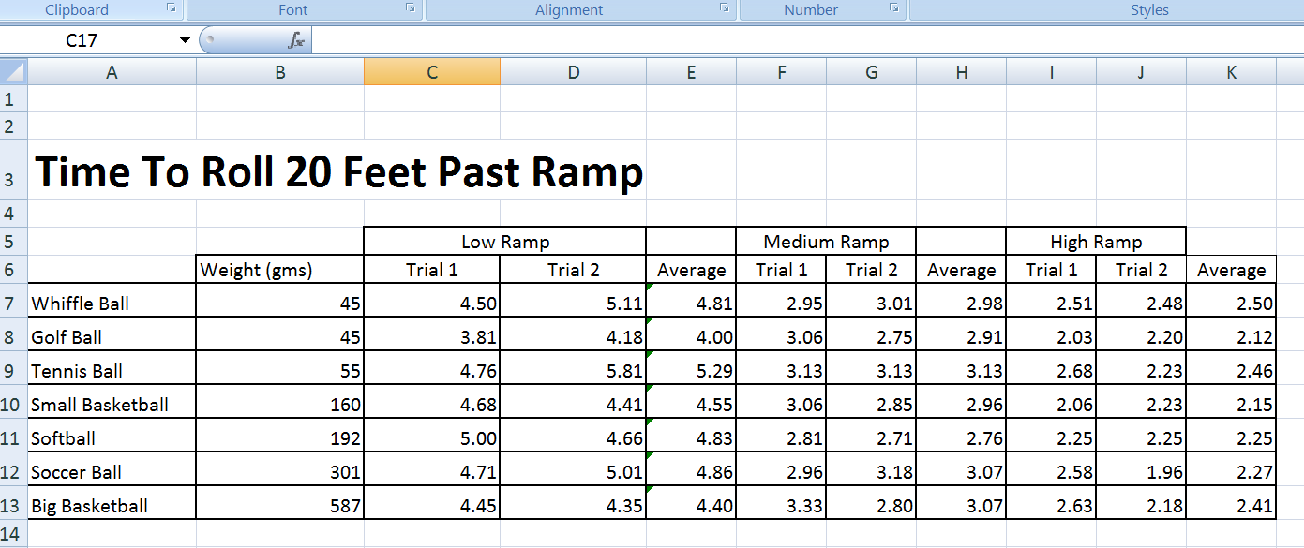
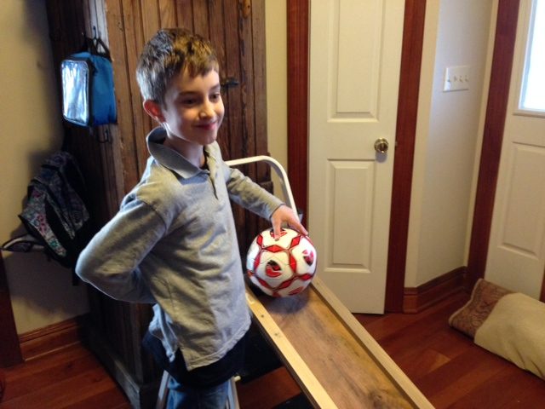
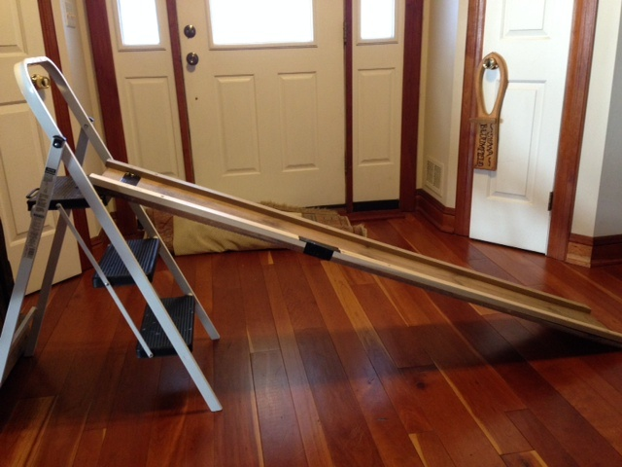
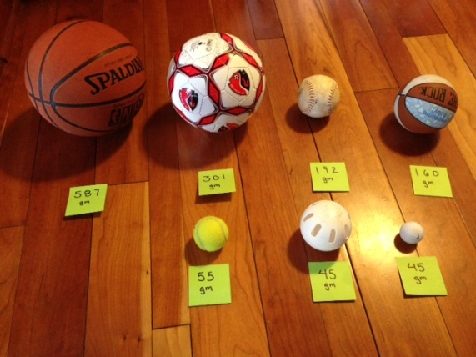
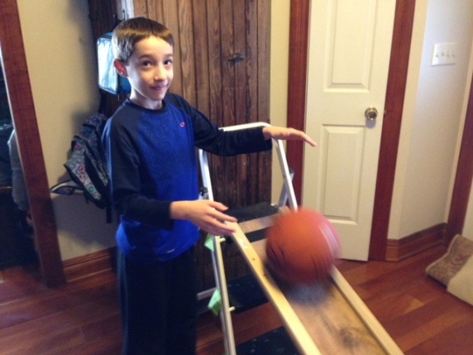
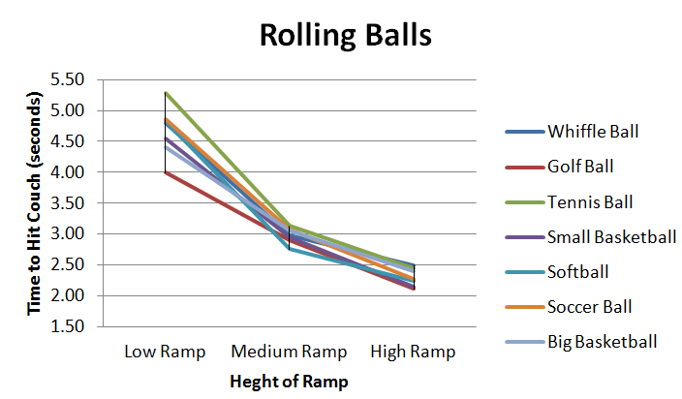
The Nature of Variability
(as told through the lens of a 4th grade science fair project)
Max
How fast does a ball roll down a hill?
The Four Types of Variability
1. Observational or Measurement
2. Natural Variability
3. Induced Variability
4. Sample Variability

Slide 25
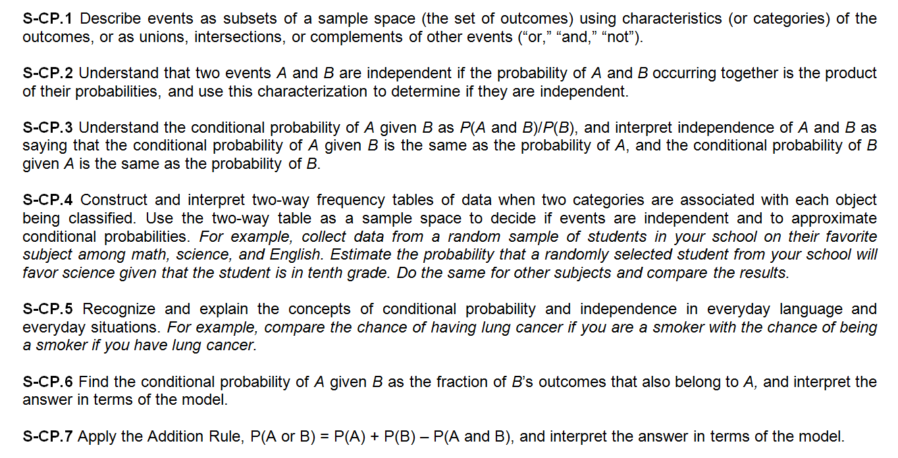
The Probability Standards

Slide 26
A Simple Conditional Probability Activity
A game is played where two fair coins are flipped simultaneously. The game ends if either coin turns up a head. What is the probability that when the game ends, two heads are showing?
What is your initial instinct in terms of the theoretical answer? Answer the first part of the Socratic quiz. Don’t think too hard about this. Imagine you ask your students this question.
Play the game at least 25 times and record the number of times the game ends and the number of times that two heads are showing. Also record the empirical probability, to the nearest hundredth, that the games ends in two heads.

Slide 27
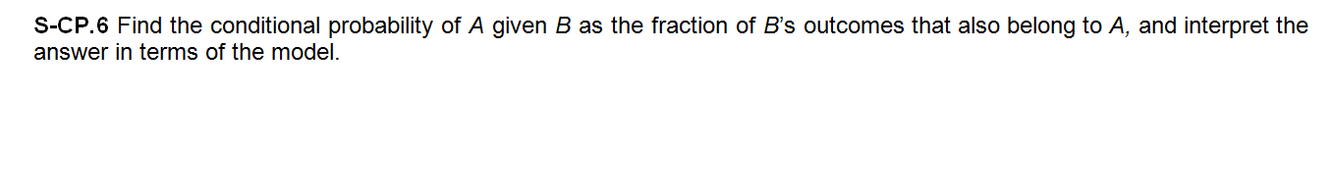
Results
A = Two Heads Are Rolled
B = Game Ends
B
A
(T, H)
(H, H)
(H, T)
(T, T)

Slide 28
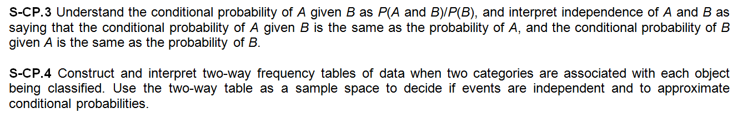
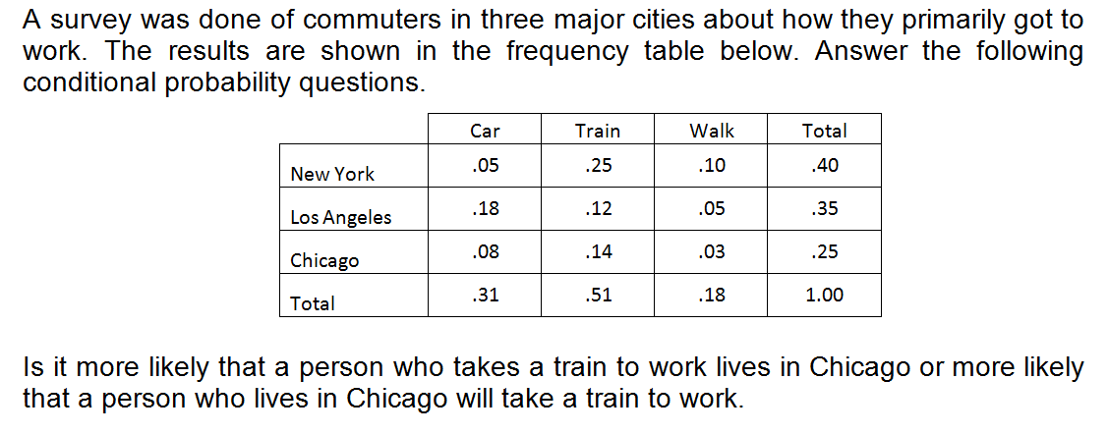
Harder Conditional Probability

Slide 29
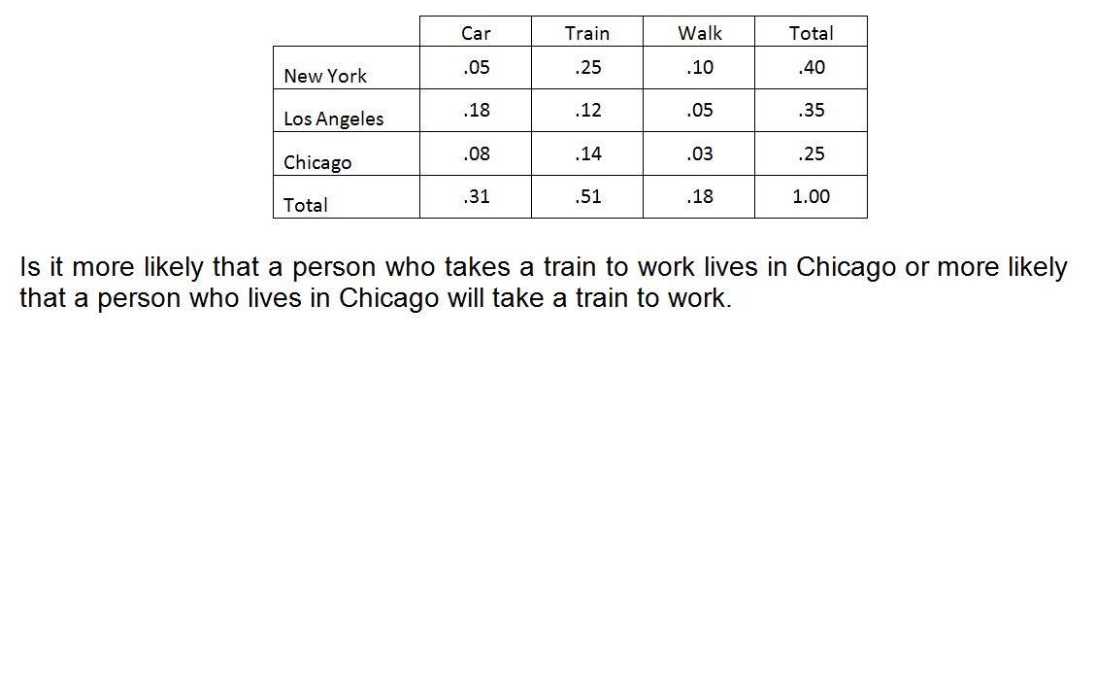
Solution

Slide 30
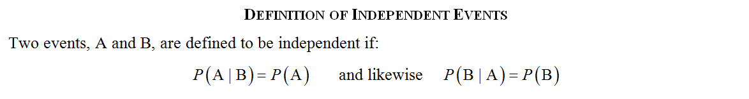
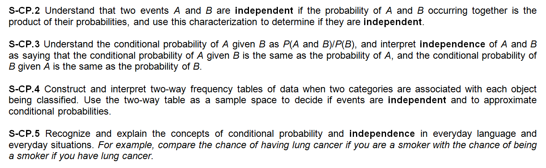
Independence

Slide 31
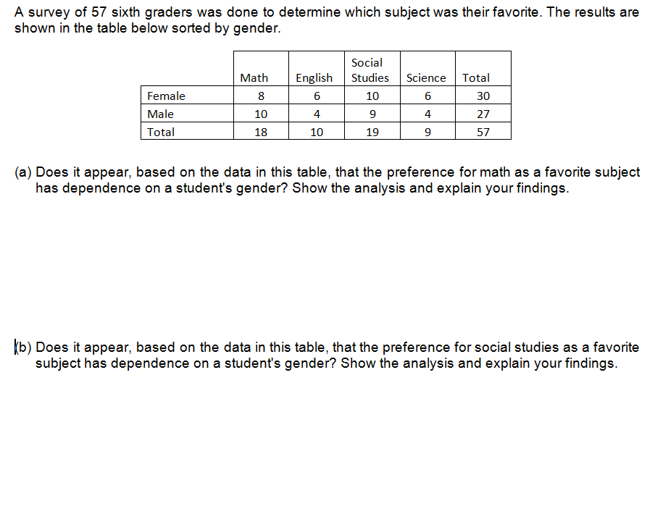
Not
independent
Independent

Slide 32
The Association Between Experience and Probability Content
The Common Core Standards do not contain any material associated with classic counting theory, including the fundamental multiplication law, permutations and combinations. But, how important is this content and does its perceived importance depend on how long someone has been teaching?
Question #1: How many years of teaching experience do you have in New York State?
Question #2: Is counting theory an essential part of high school probability education?
 | Counting Essential | Counting Not Essential | Total
Less than 10 years
10 or more years
Total

Slide 33
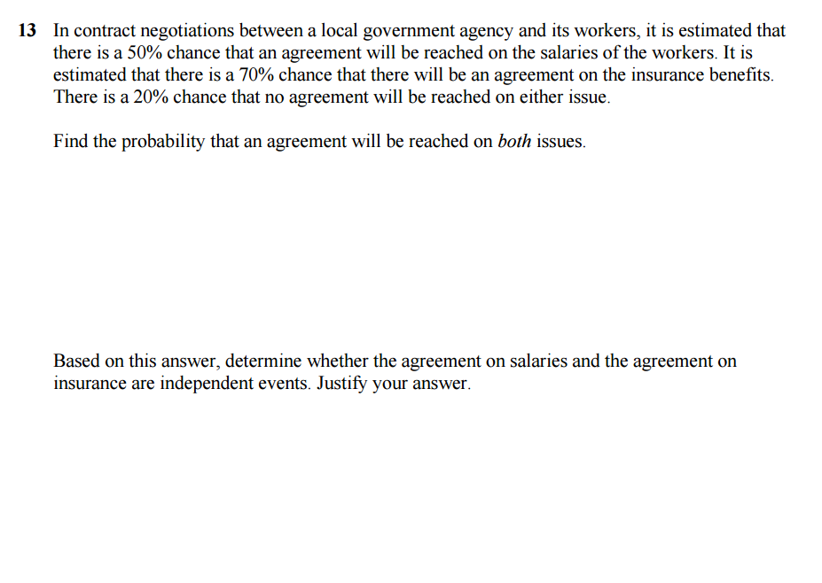
A Sample Non-Sample Problem
Approach 1
Approach 2

Slide 34
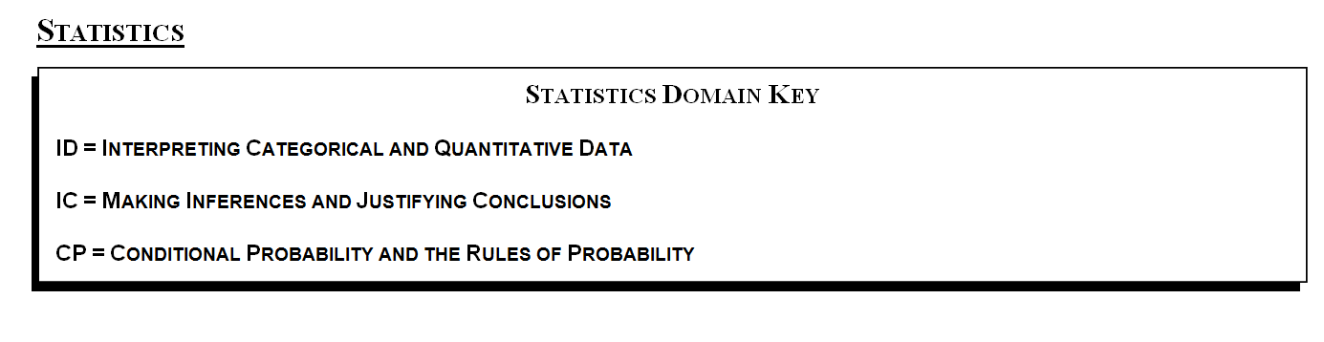
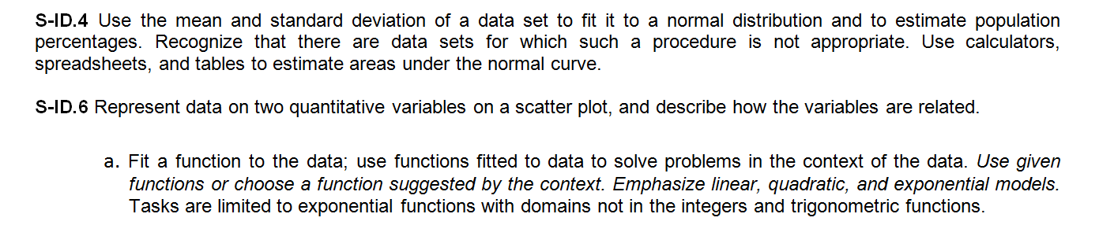
The Statistics Standards

Slide 35
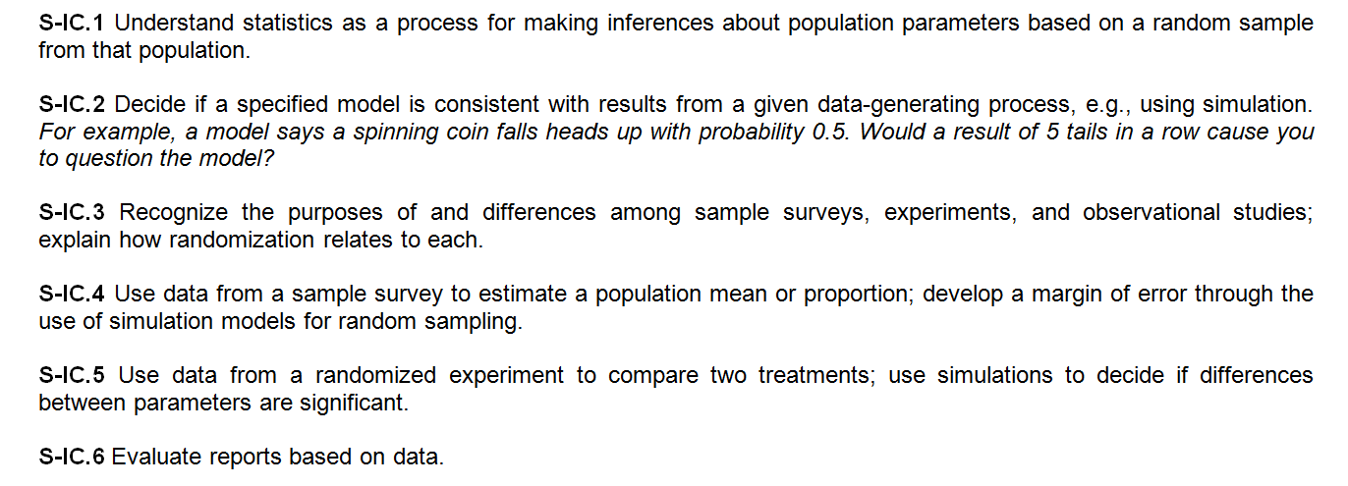

Slide 36
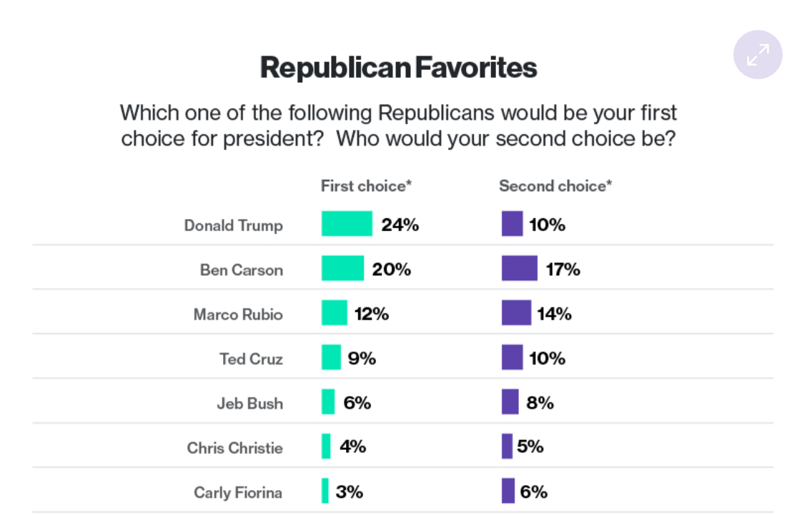

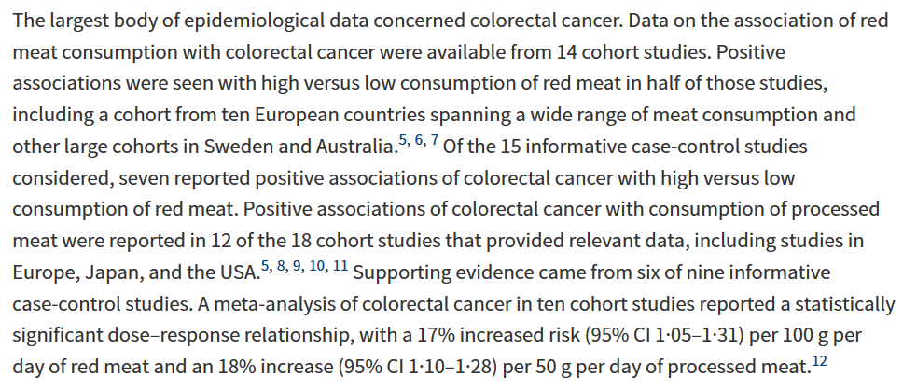
Evaluating Reports Containing Data

Slide 37
Making Inferences from Samples
This standard gets at the heart of inferential statistics. As with many of these standards, it is hard to know how it will be assessed, but we can certainly provide students with rich learning experiences. We begin today with trying to infer what our overall mean experience level is by taking samples.
How experienced are we?

Slide 38
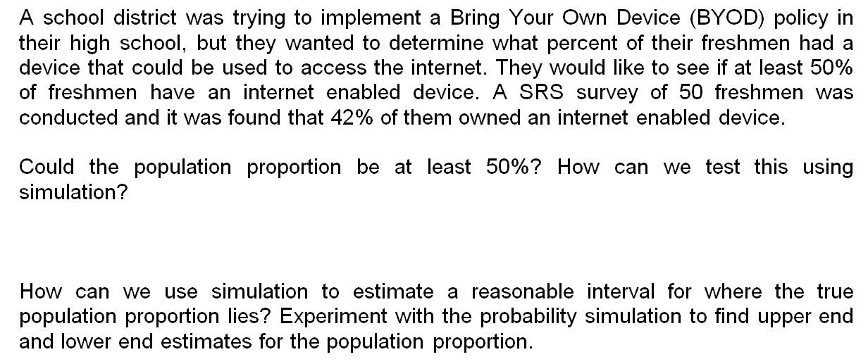
Using Simulation in Inferential Statistics

Slide 39
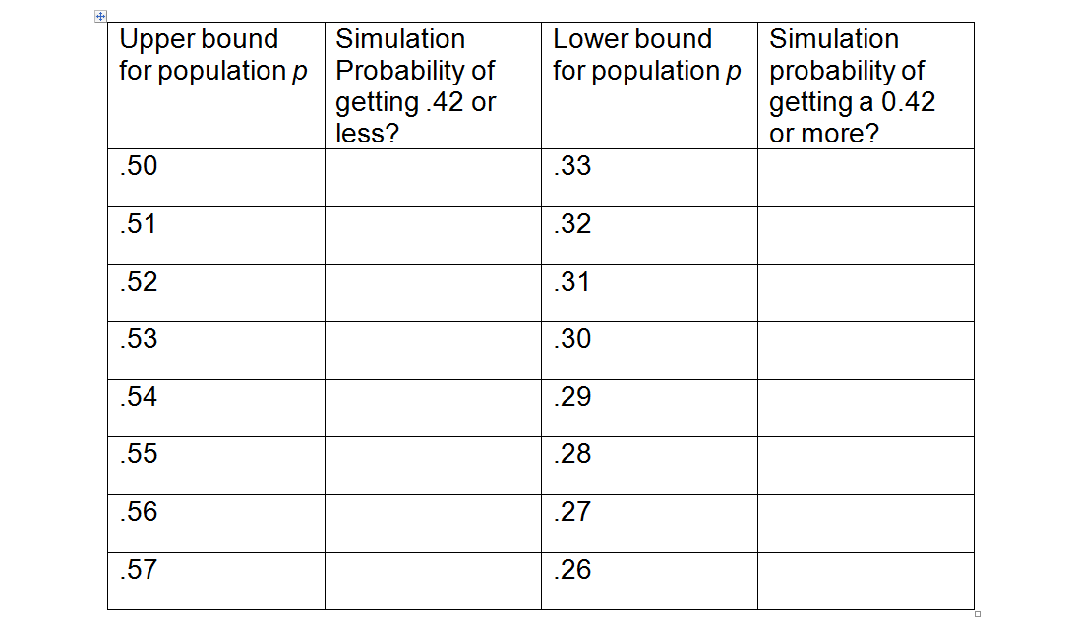
Using Simulation in Inferential Statistics

Slide 40
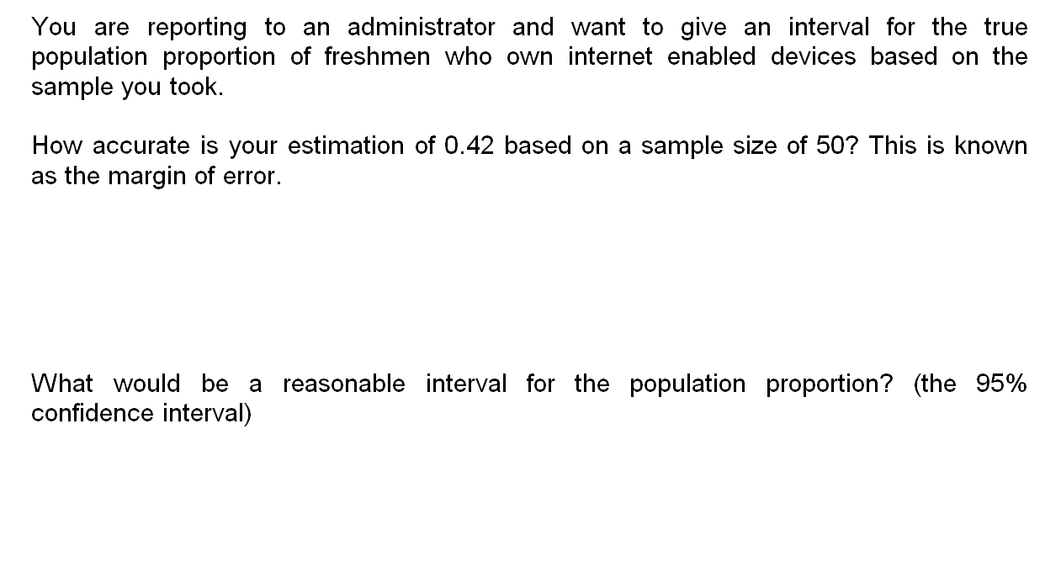
Using a Formulaic Approach
Since 95% of all sample proportions will fall within two standard deviations of the population p, we simply need to calculate the standard deviation of the sample p’s.

Slide 41
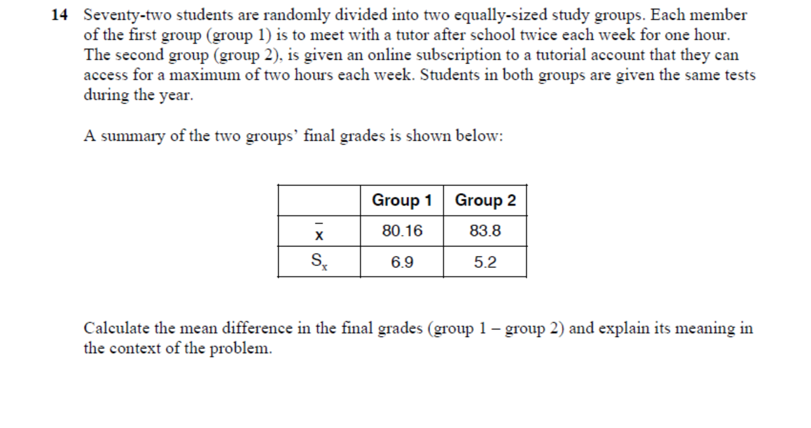
Difference in Sample Means
Students who did not meet with a tutor scored, on average, 3.64 points less than those who did.

Slide 42
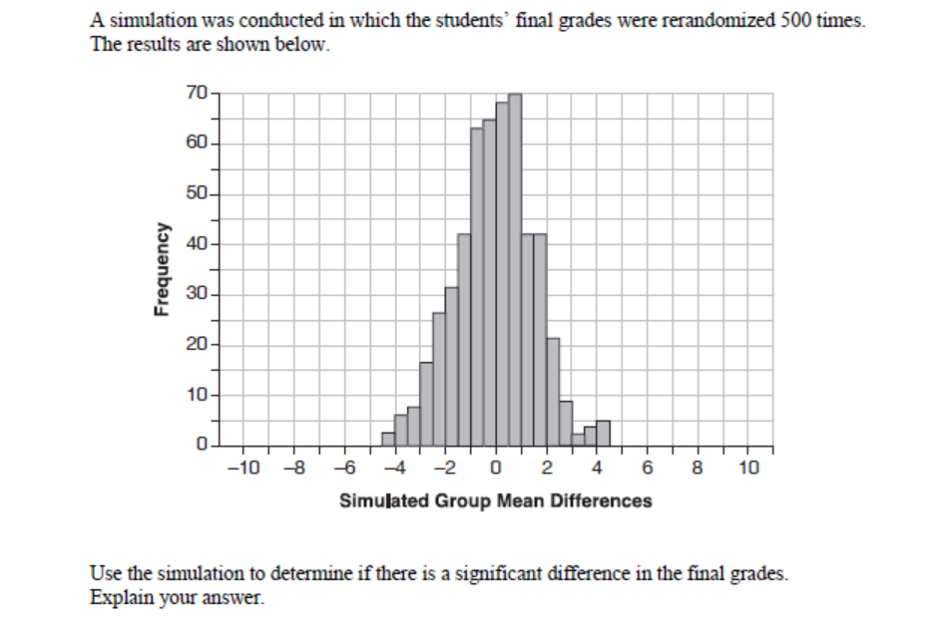
Difference in Sample Means

Slide 43
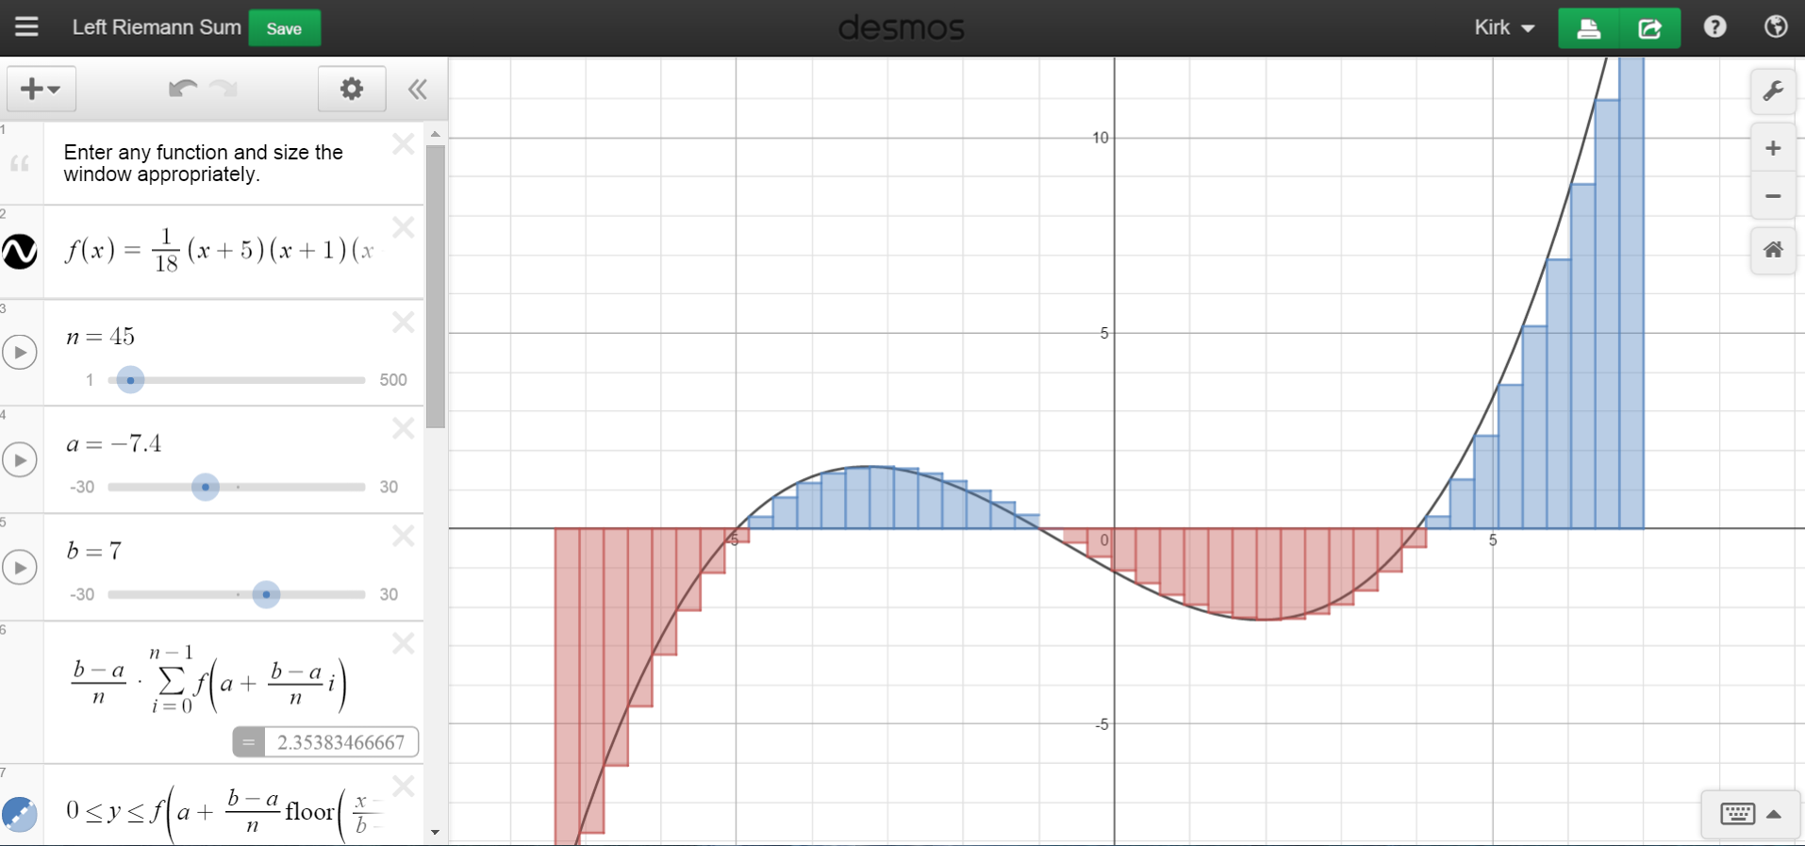
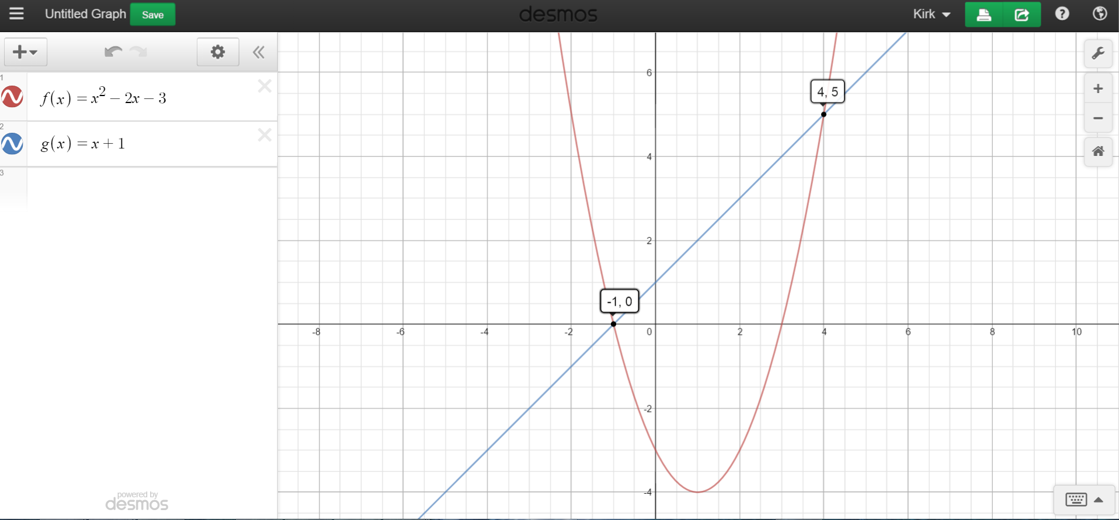

Desmos
(aka biggest distraction ever)

Slide 44
Desmos Basics
Entering equations
Graphing points
Graphing inequalities
Adding sliders
Accessing the Desmos keyboard

Slide 45

Desmos and Transformations

Slide 46


Polynomials and Roots

Slide 47

Trigonometry

Slide 48
Thank you for coming!
For more resources, please consider visiting our website at:
www.emathinstruction.com
Email me at: Kirk@emathinstruction.com
eMathInstruction

